Slide 1
IDN BENEFITS
AVAILABLE BUT UNDER UTILISED – WHY?

Slide 2
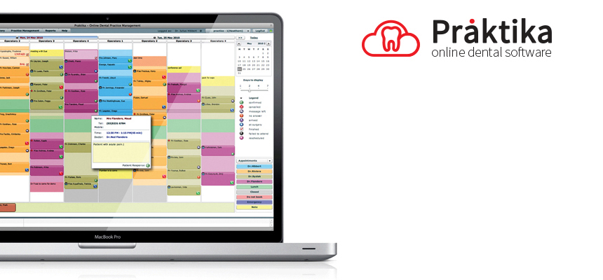
Praktika – Online Dental Software
Cloud based – Australian Company – well established – open to user improvement suggestions.
Benefit : 25% discount on all services for IDN members

Slide 3
Mediref is so quick and easy to use and it is reassuring to know patient referrals are sent securely. I have come to rely on Mediref so much that it is great to have such comprehensive backup and support.
Benefit - cost just $5 pw.

Slide 4
IT My Way
COMPREHENSIVE I.T. SERVICE TAKING RESPONSIBILTY FOR ALL IT OPERATIONS INCLUDING MAINTENANCE. UPGRADES.CYBER SECURITY. DISASTER RECOVERY. 24 HOUR SUPPORT SERVICE.
Remove one operations worry and save money and time.

Slide 5
WCEA - Continuing Professional Development
The WCEA specializes in Continuing Professional Development Learning Management Systems and connecting learners with leading educators through our global network of CPD courses.
Benefit: Meet CDE requirements at your home convenience.
Upgrade your staff skills at very affordable cost.
Introduce career development into your practice to attract
“A” grade team members

Slide 6
Success Dynamics Alliance
It is a fact in the harsh reality of today's modern world.
Interviewees are becoming more and more educated and therefore, it is becoming harder and harder to decide whether or not an individual would really be a good fit for an organization.
Don’t rely on a good resume- don’t rely on a good impression.
Find out what the person is really like and whether they are a god fit for your team and loyal.
The science is proven –the cost is small A$150

Slide 7
Marketing : JOLT MEDIA
Jolt Media specialise in helping you and your business succeed via providing high quality 3D tours for your business.
New patients want to try before they buy – they want to see what your practice and the people in are like – via the internet.
Adding a virtual tour of your practice lowers the entry barrier.
Maximise the opportunity you have when people visit your web site.

Slide 8
MARKETING: 5 TALES MARKETING
70% OF BUSINESS IS NOW DONE OVER THE INTERNET AND IT WILL ONLY INCREASE.
Most dentists are wasting money when outsourcing web based marketing. Most dentists are too time deprived to successfully manage Social Media Marketing.
We have contracted a first class digital marketing agency and that will run campaigns in order to generate a positive ROI on the long-term investment you make.
In addition to SEO and digital marketing services they are also able to offer Adwords management and social media marketing

Slide 9
5 TALES MARKETING
FREE review of members web site and social media marketing.
Too many of us are guilty of neglecting the updating and functions of our web pages. Time and other pressures take precedent.
An expert assessment of your current web page provides the opportunity to quickly review and update and improve performance.
We are working our way through all members sites to improve and save money.

Slide 10
The Drill Guys
Free Membership.
14 day account.
Fixed price for 24 months.
12 months warranty on all parts ( excepting bearings replacements-6 month warranty.)
2 free onsite inspections each year.
2 free on site maintenance educations sessions

Slide 11
The Drill Guys
The Drill Guys Current Pricing Schedule |  | IDN 20% Discount
STANDARD REBUILD (Ceramic Bearings/O-rings) | $250.00 | $200.00
CANISTER REPLACEMENT (NSK Models) | $250.00 | $200.00
PREMIUM REBUILD (Turbine/Bearings/O-rings ) | $395.00 | $316.00

Slide 12
Practice Marketing Guidelines
marketing-guidelines-web
tips-for-cost-effectively-marketing-your-dental-practice
tips-on-how-to-get-the-most-value-from-your-website
A comprehensive 52 page guide to help you market your practice effectively and get value for money.
Free download from Members section of IDN web page.

Slide 13
IDN Website - Posters and Flyers
We have a wide range of print ready marketing materials that can be downloaded in Members Section of IDN web page.
Included are posters, flyers and banner adverts for your web page.
These high cost items are being under utilised. WHY??

Slide 14
PRACTICE PLANS
Preventative Care Plan.
Savings Plan.
The need is there – 48% of people do not have Health Insurance.
38% of people with Health Insurance are deeply dissatisfied.
The ADA is strongly recommending the Government introduce a Health Savings Plan with a taxation deduction.
WE have a plan- it is ready to go- why is there no take up?????

